Slide 1



Online Retailer Customer Segmentation
Data Science Capstone
Spring 2022 SECS 7259-01 22124
Vidya Rayanoothala

Slide 2
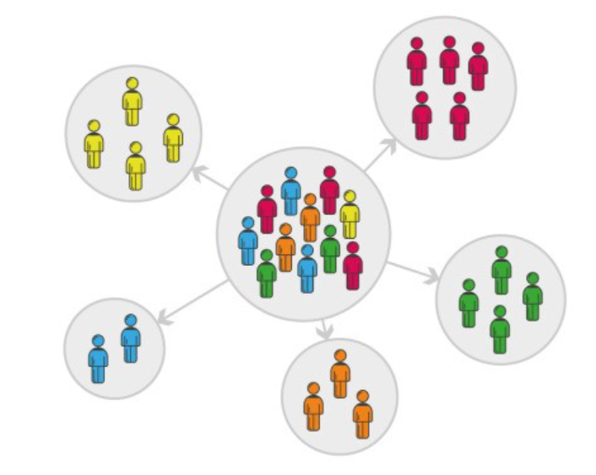
Online Retailer: Business Objective
Need to explore: E-Commerce past infancy
Maximize efficiency leads to profits
Understand customers key to success
Business Objective: Understand customer to enhance Product offering and maximize profit
Scope and Design: Customer Segmentation
Data preparation: Data Exploration, Data Cleaning
Descriptive analysis: Visuals to derive insights
Unsupervised learning model: Clustering
Dimensionality reduction
Baseline: K-Means Elbow method to find clusters
Hierarchical or Partitioning clustering or RFM Model
Model iteration and best fit
Examining with scatter plots
Evaluating model
Model Implementation
Stakeholders: Online Retailer, Customers, Support functions

Slide 3
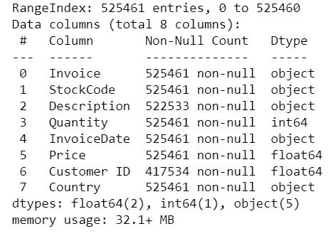
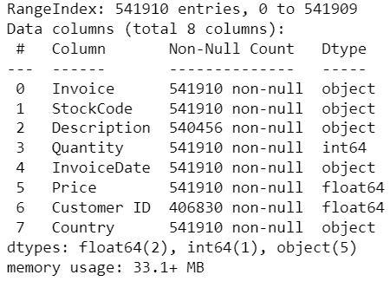
Data Acquisition
- Transactions for a UK-based and registered, non-store online retail between 01/12/2009 and 09/12/2011
- Source: Dr. Daqing Chen, Course Director: MSc Data Science. School of Engineering,
London South Bank University, London SE1 0AA, UK.
https://archive.ics.uci.edu/ml/datasets/Online+Retail+II
Reference:
https://www.kaggle.com/datasets/lakshmi25npathi/online-retail-dataset?select=online_retail_II.xlsx
Online Retail: Year 2009-10
Online Retail: Year 2010-11

Slide 4
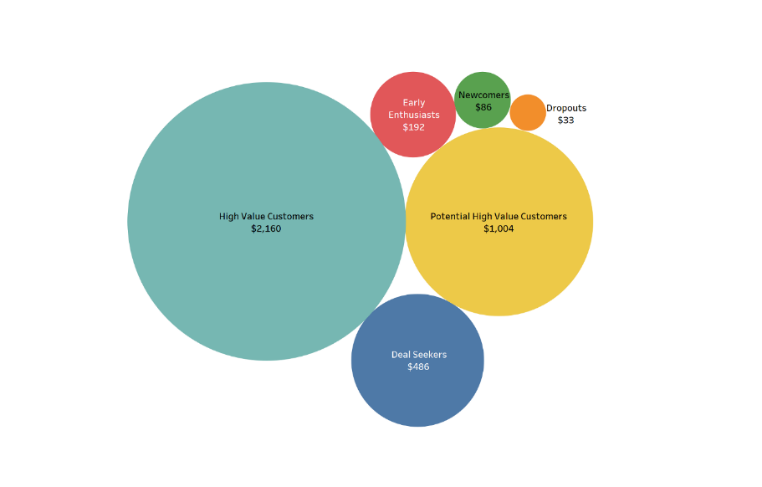
Online Retailer:
Main consumers of the model:
Online retailers looking for optimizing product offerings
Online retailers expanding into new geographic locations
Retailers exploring Online space
Risks:
Not all models are true always
Choosing the right algorithm for the job is no easy task
Data-mining complexity involved in identifying distinctive clusters
Skewness to UK impacted by Exogenous influences like Brexit, Supply chain issues

Slide 5
Online Retailer Week 2 Customer Segmentation
Data Science Capstone
Spring 2022 SECS 7259-01 22124
Vidya Rayanoothala

Slide 6
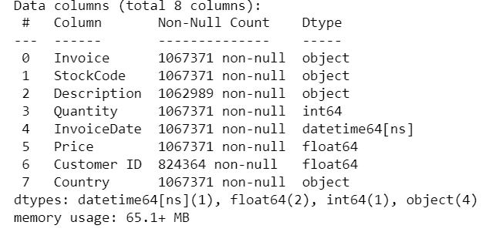
Online Retailer: Data Cleaning
Step 1: Combined 2 worksheets:
Year 2009-10 and 2010-11
Total 1067371 entries
Step 2: Removed entries without Customer ID
Reduced to 824364 entries
Step 3: Outliers: Negative Quantity and Price
Order Cancels have Negative Quantity. Also ‘C’ on Invoice number
Negative Price marked for bad debt adjustments (5 entries)
2 Bad debt adjustments (=22k amount) same date 12/8/11
Step 4: Exploratory Data Analysis
Amount spent by each Customer (ID)
Frequency of purchase
Value of each purchase
Country of purchase volume
Amount spent per country
Seasonality - Month of purchase

Slide 7
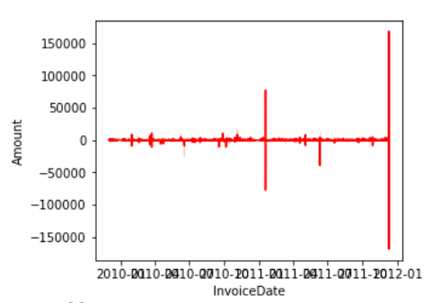
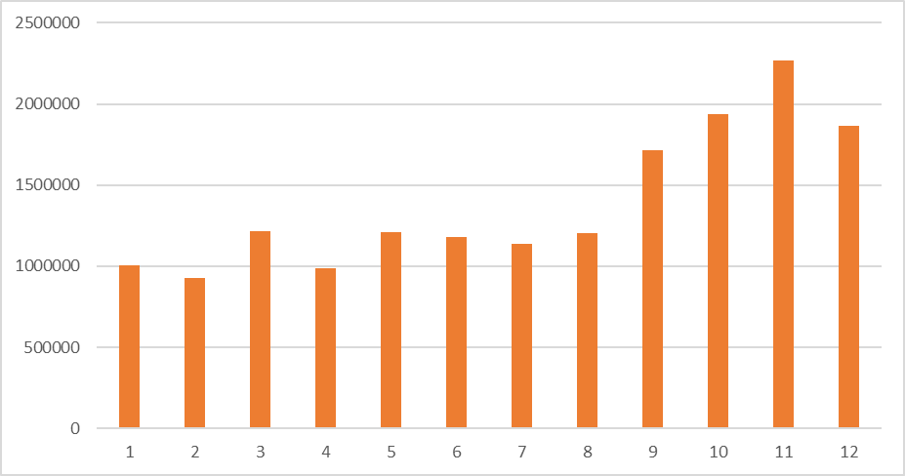
Online Retailer: Prelim learning
Revenue Generated in 2 years
5942 customers spent on average 2801.80 currency
Each customers had purchased on average approx. 7.5 times in 2 years, at least once and at most 508 times
On average, 293.97 spent by a customer on a purchase
75% of customer purchases within 357.41
Most Customers and most revenue generated from United Kingdom
Ireland, Netherlands, Germany, France, and Australia - top Revenue generating countries/ markets
Seasonality in revenue generated
Peak months: Q4 – Oct to Dec
Month over Month: Revenue Generated

Slide 8
Online Retailer: Next Steps
Analyze if any pattern in Cancel orders by Country, purchase Date/ month, Recent
Begin with RFM Analysis
Compliment findings with predictive analysis using K-Means Clustering Algorithms

Slide 9
Online Retailer Week 3 Customer Segmentation
Data Science Capstone
Spring 2022 SECS 7259-01 22124
Vidya Rayanoothala

Slide 10
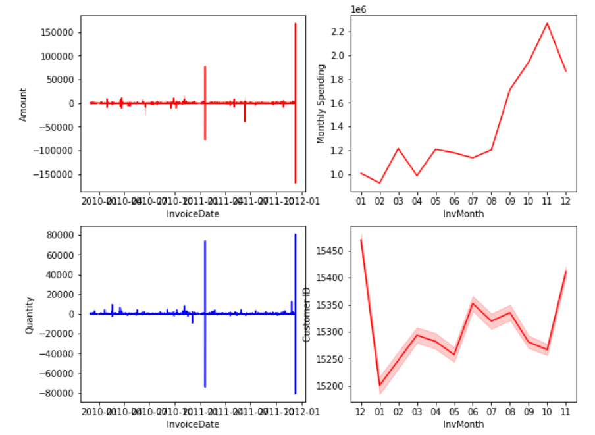
Online Retailer: Exploratory Data Analysis (contd.)
Further review of Cancel Orders:
Mainly coincided with peak order days
About a third of customers cancelled orders
Equates to just 8% of revenue
Top 3 Most cancels by Countries that order revenue with in Top 5:
United Kingdom
EIRE
France
About 49% of products have had cancelled orders

Slide 11
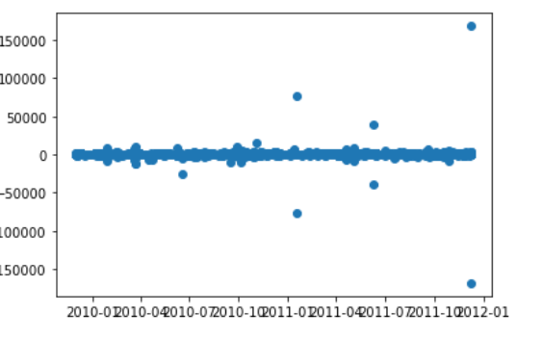
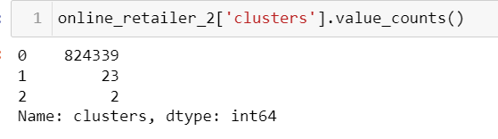
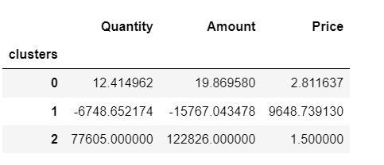
Online Retailer: Baseline vs. V1 model
Scatter plot of Revenue Generated
Scatter plot of revenue to time distribution indicated 3 clusters
Cluster 0: Orders with moderate revenue generation
Cluster 1: Orders that were cancelled and resulted in loss of revenue
Cluster 2: Orders with high revenue generation
K Means with 3 clusters shows similar composition as scatter plot clusters
Clusters Composition: v1

Slide 12
Online Retailer: Next Steps
Further work on K-Means Clustering to find Optimum K with Elbow method
Find the difference compared to hierarchical clustering
Reassess the clusters without cancelled orders

Slide 13
Online Retailer Week 4 Customer Segmentation
Data Science Capstone
Spring 2022 SECS 7259-01 22124
Vidya Rayanoothala

Slide 14
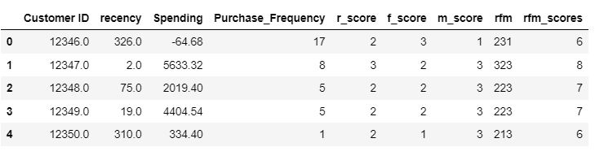
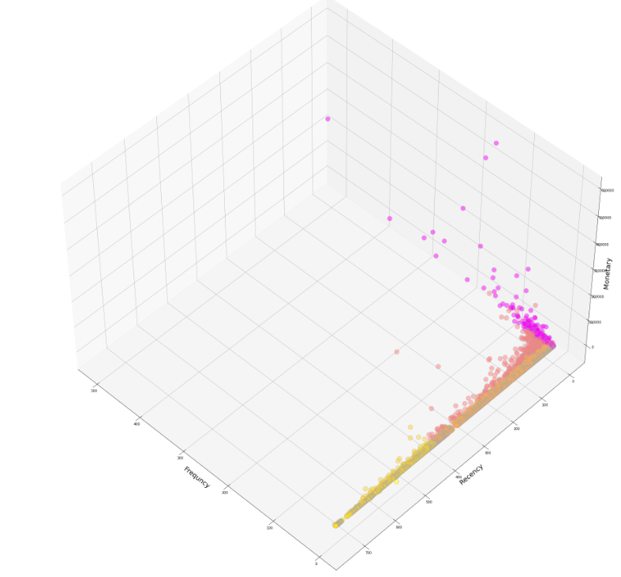
Online Retailer: V2 Model
RFM and scores
RFM Model
Customer behavior segmentation technique
Customers’ historical transactions: Recency, Frequency, Monetary
Each component split into quartiles
Scores for each component assigned from quartiles
Overall Score generated based on
how recently customer bought products,
how often customer buys, and
how much money was spent by customer,
Considering each component and with Recency at higher weights, model designed with 7 clusters
However scatter plots does not support 7 clusters
3D scatter plot: RFM

Slide 15
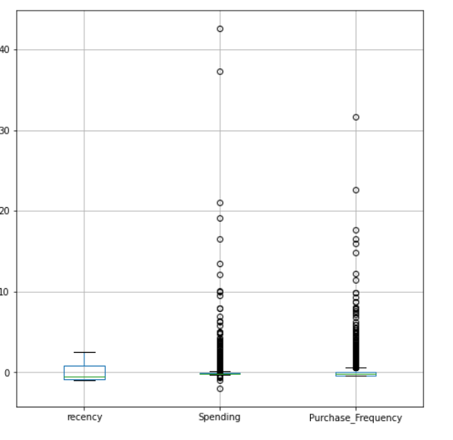
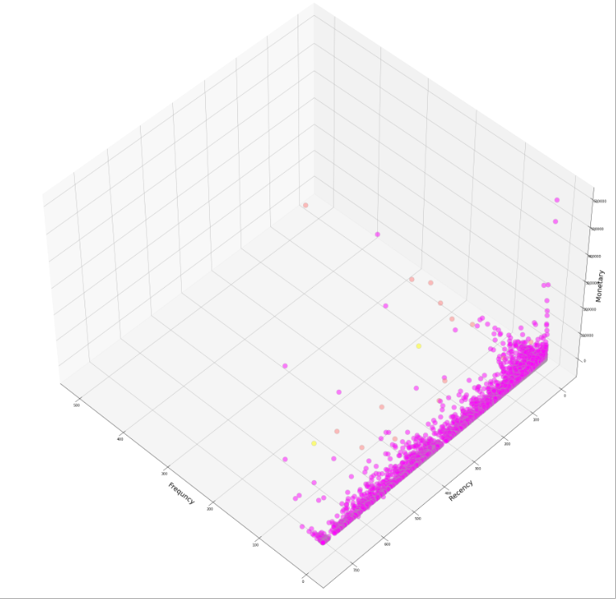
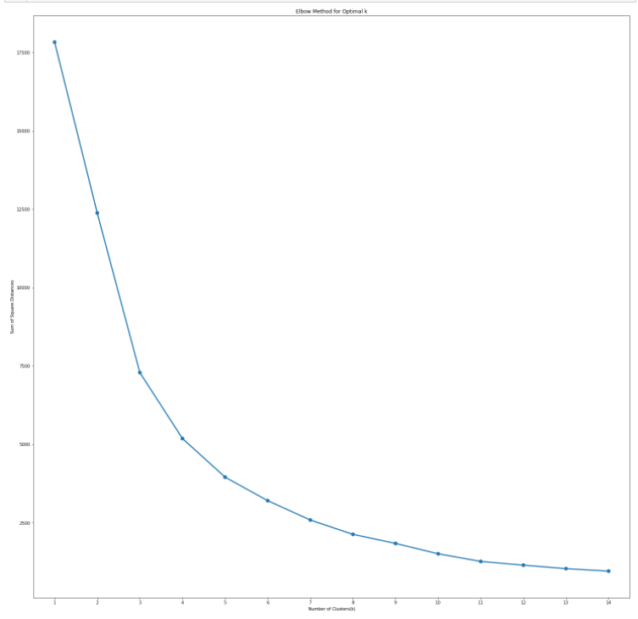
Online Retailer: V2 model
Normalized RFM: Outliers removed Box plot
Box plot showed Outliers in Data
Used standard scalar to normalize data
Elbow method to find optimal K indicates 3 clusters
Low Monetary value
Medium Monetary value
High Monetary value
Elbow method and 3 Clusters

Slide 16
Online Retailer: Next Steps
Further work on remove outliers as seen with Box plot
K-Means with 3 Optimal clusters K not clearly breaking down the groups
Subset data with only UK customers, exclude cancelled orders

Slide 17
Online Retailer Week 5 Customer Segmentation
Data Science Capstone
Spring 2022 SECS 7259-01 22124
Vidya Rayanoothala

Slide 18
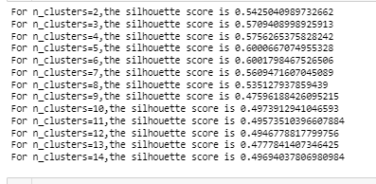
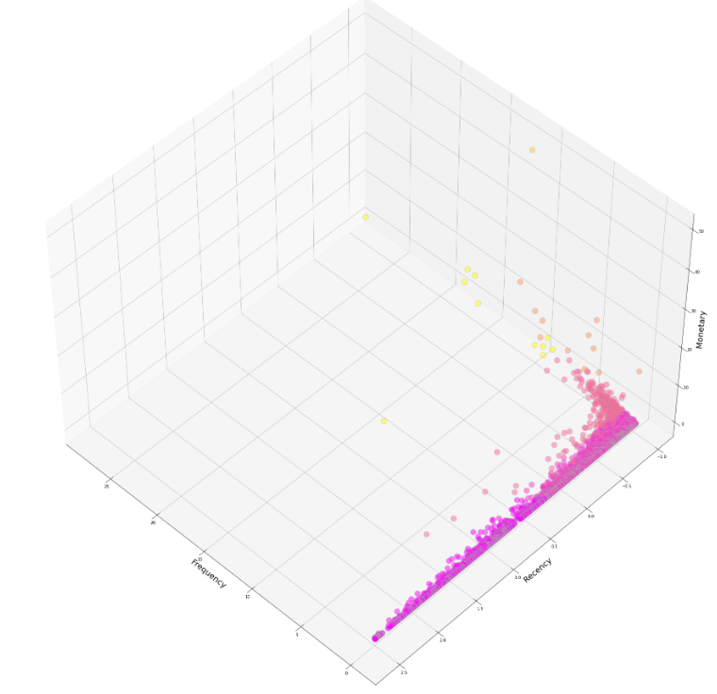
Online Retailer: Final Model
Silhouette score and Clusters
Data cleanup
Removed negative Quantities and negative Price
Removed other countries except UK
Normalized and Scaled
Silhouette Analysis for Clusters
Silhouette Coefficient or score is a metrics to calculate goodness of clustering technique
1=> clusters are well apart from each other and clearly distinguished.
0 => clusters are indifferent, or we can say that the distance between clusters is not significant.
-1 => clusters are assigned in the wrong way
Applying on Online Retailer dataset, 6 clusters highest Silhouette coefficient
3D scatter plot: RFM

Slide 19
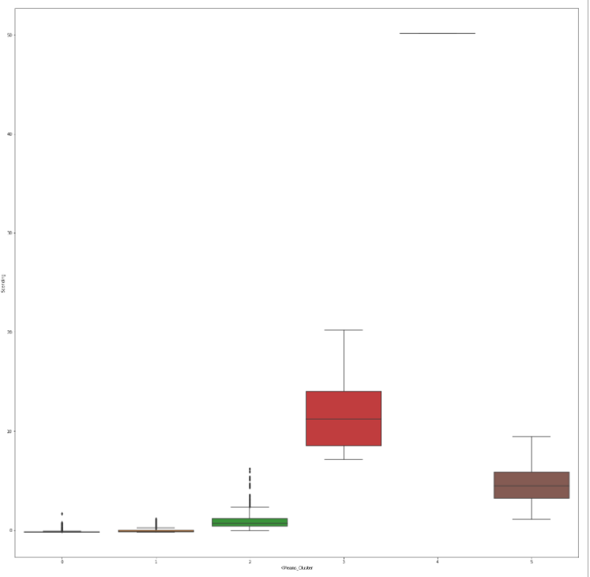
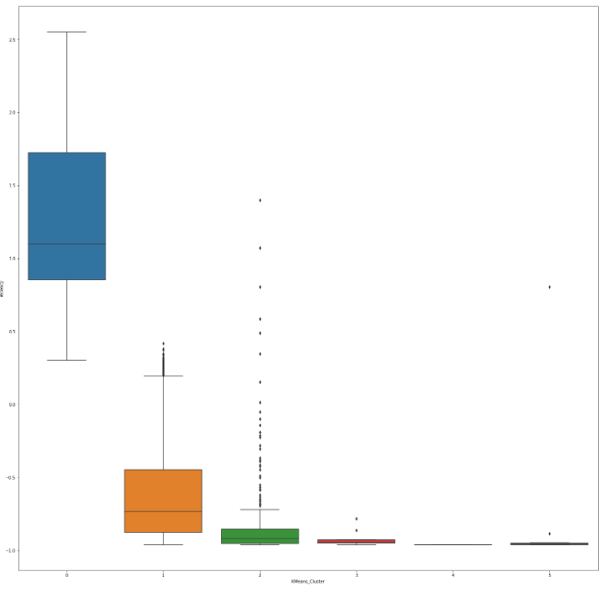
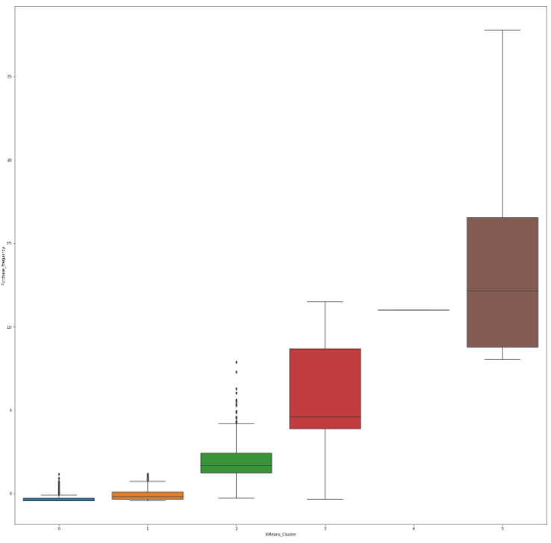
Online Retailer: Final model
6 Customer Segments or clusters
Low Monetary value purchases, Most Recent, and Low Purchase Frequency
Low Monetary value purchases, Less Recent, and Low Purchase Frequency
Low Monetary value purchases, Not Recent, and Lesser Purchase Frequency
High Monetary value purchases, Not Recent, and Higher Purchase Frequency
Very High Monetary value purchases, Not Recent, and Higher Purchase Frequency
Medium Monetary value purchases, Not Recent, and High Purchase Frequency
Spending/Monetary
across Clusters
Recency across Clusters
Purchase Frequency across Clusters

Slide 20
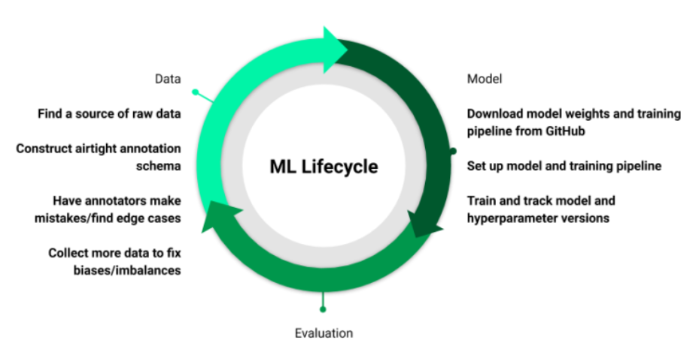
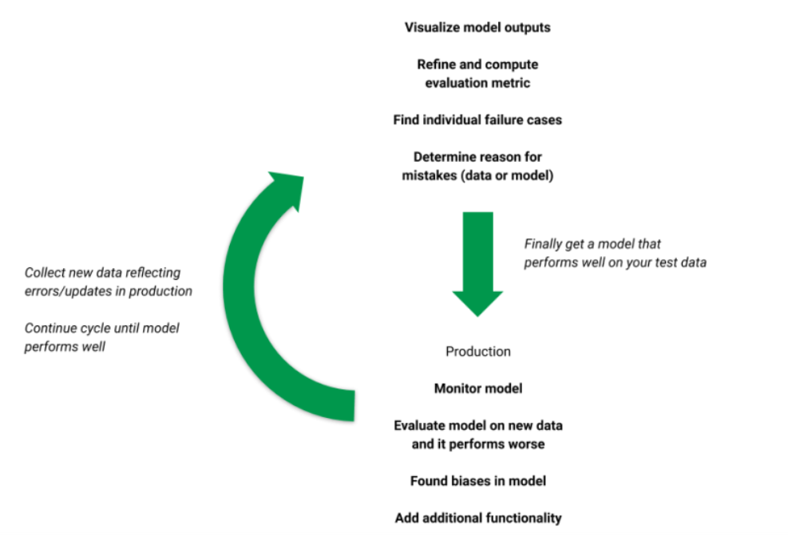
Online Retailer: Model Profiling
Model deployment and Validation
Canary deployment strategy: Gradually add customer country
Internal Validation: Evaluating the fitness and Stability of clustering
Geometrical Properties of cluster like Compactness, Separation, Connectedness: Average Silhouette Width, and Bayesian information criterion (BIC)
Risks of model:
Every clustering algorithm will find clusters in a dataset, even if there is no cluster structure in it
Country specific
No Cancel orders
Extreme outliers will skew clusters
Stakeholders for project:
Online Retailer, Customers, Support functions
Marketing team for building nurture campaigns via emails, texts
Finance team for determining profitable offers and discounts
Product purchase and maintenance team for stocking products
Data Science team for building and maintenance of Customer segmentation model
Reference: https://neptune.ai/blog/model-deployment-strategies
Source: The Machine Learning Lifecycle in 2021

